Slide 1


WOMEN SAFETY DEVICE
STUDENT MEMBERS
AKSHAYA R L
SUBASHI S
VASUNTHRA R S
III YEAR ECE
VELAMMAL COLLEGE OF ENGINEERING AND TECHNOLOGY MADURAI.
National Productivity Week 2023 Celebration
Organized by
MADURAI PRODUCTIVITY COUNCIL
In association with
VELAMMAL COLLEGE OF ENGINEERING AND TECHNOLOGY, (Autonomous)
FACULTY MENTOR
Dr.SUVEETHA P DHANASELVAM

Slide 2
CONTENTS
Introduction & Objective
Hardware Used
Methodology
Advantages
Disadvantages
Applications
Future scope.

Slide 3
INTRODUCTION
Women safety is a very important issue due to rising crimes against women these days.
To help resolve this issue, a GPS based women safety system is proposed that has dual security feature.
This device consists of a system that ensures dual alerts in case a woman is harassed or she thinks she is in trouble..

Slide 4


NEWS ARTICLE

Slide 5

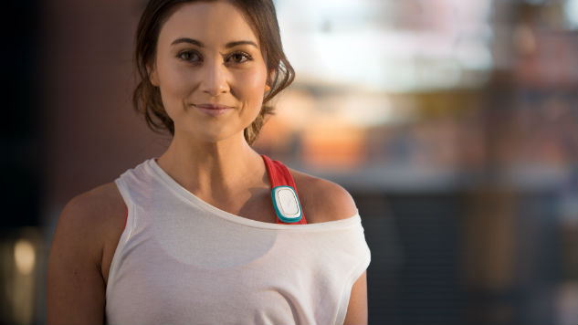
WOMEN SAFETY DEVICE

Slide 6
HARDWARE USED
Arduino Uno
GSM Module
GPS Module
Fingerprint Scanner
Power supply
Buzzer
LEDs
LCD Display
Push Buttons
Capacitors
Resistors

Slide 7
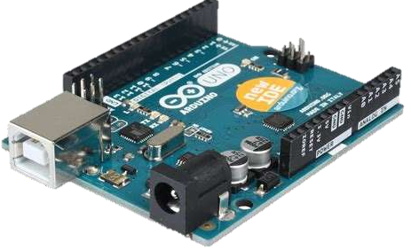
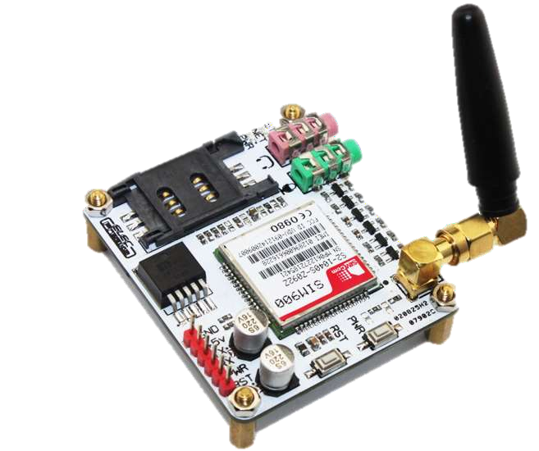
AURDINO UNO
It is an open source computer hardware and
software.
It is designed to use a variety of microprocessors and controllers
GS Module
It is a ARM based embedded GPS module
GPRS (General Packet Radio Services) is a packet based wireless communication service which is used for various data applications on
phones, including wireless Internet (WAP),
MMS and software that connects to the Internet.

Slide 8
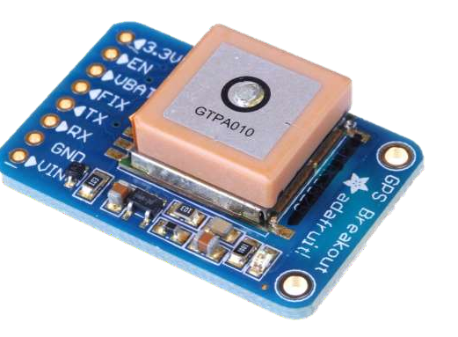
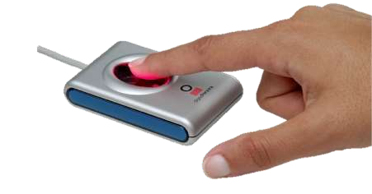
GPS Module
A GPS is a device that is capable of receiving information from GPS satellites and then to calculate the device's geographical position.
Fingerprint Scanner
A fingerprint sensor is an electronic device used to capture a digital image of the fingerprint pattern.

Slide 9
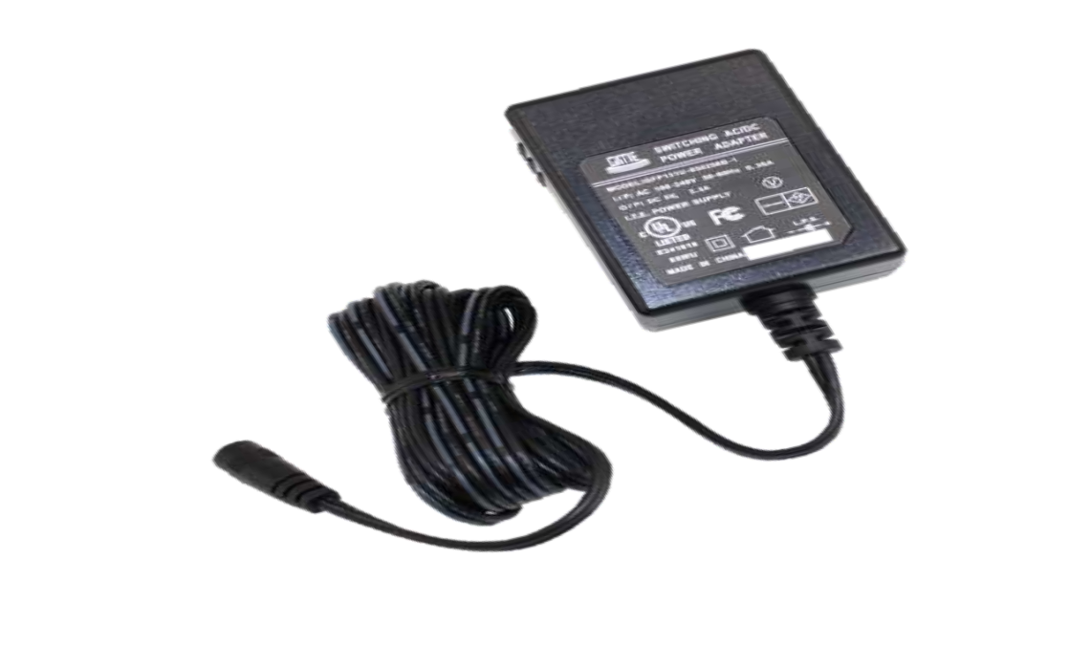
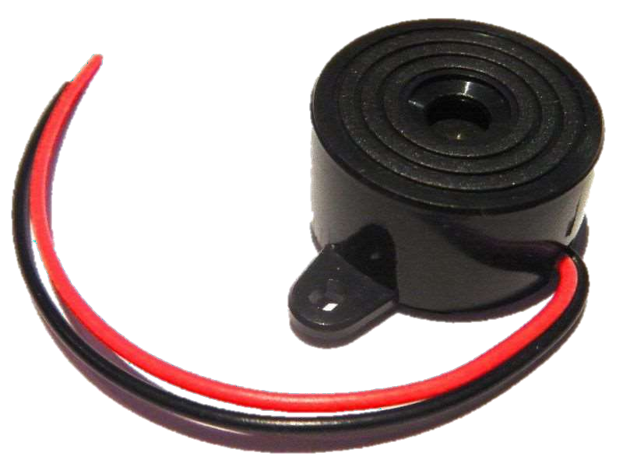
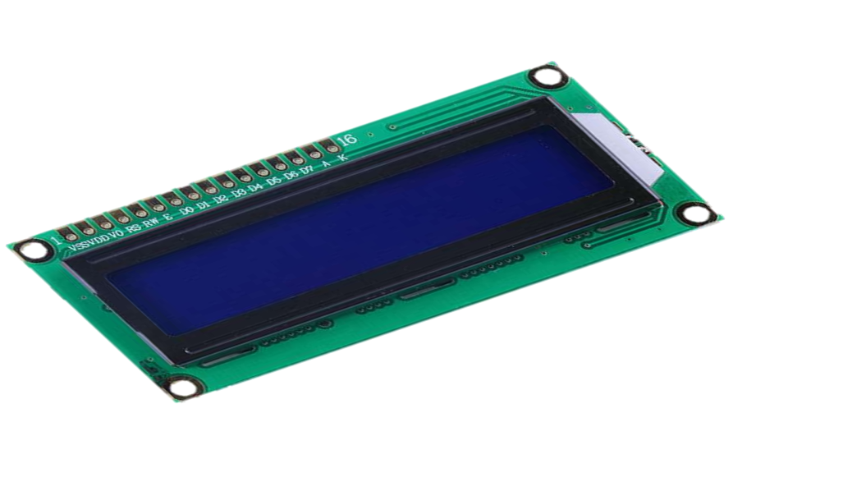
Power Supply
It is an electrical device that supplies electric power to an electric load.
Buzzer
A buzzer or beeper is an audio signaling device, which may be mechanical, electromechanical.
LCD Display
It is a flat- panel display or other electrically modulated optical device that uses the light-modulating properties of liquid crystals.

Slide 10
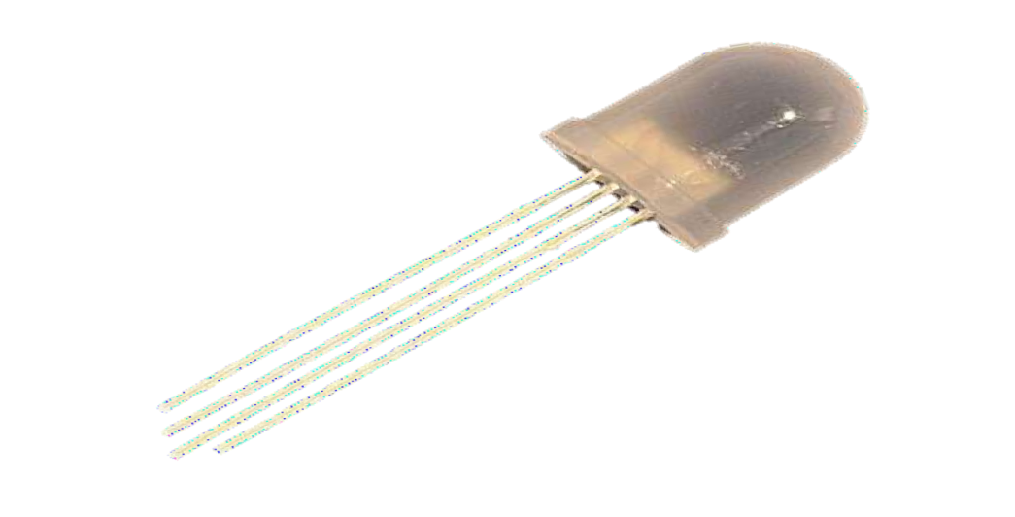
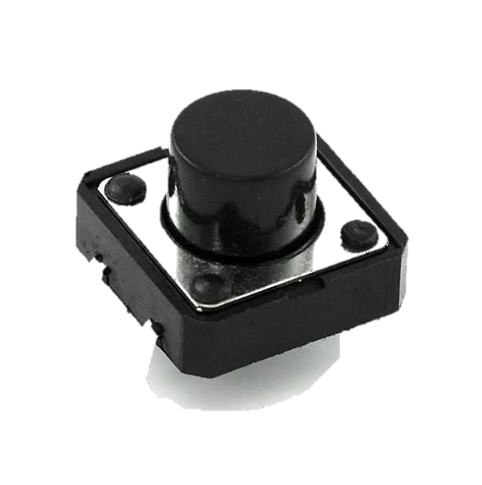
LEDs
It is a two-lead semiconductor light source with a p-n junction diode that emits light when activated.
Push button
A simple switch mechanism for controlling some aspect of a machine

Slide 11
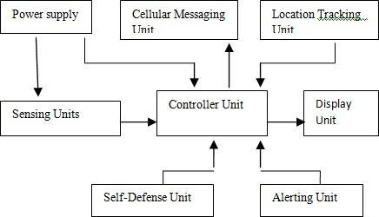
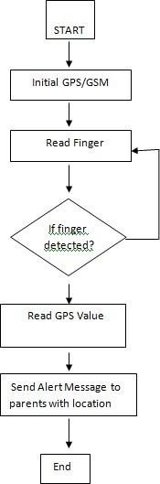
Block Diagram

Slide 12
METHODOLOGY
Power is supplied to the system.
The Arduino UNO is programmed in Arduino IDE.
LCD display is the display where user can see the status of the system.
Fingerprint scanner is connect to Arduino UNO for taking the fingerprint of the user and send to Arduino.
GPS + GSM module is connected to Arduino UNO, this two module collects the information and sends data to Arduino UNO.
Buzzer is an audio signal device, which is used to buzz sound whenever it is needed.
At last, a SMS(Short Message Service) is sent to a phone.

Slide 13
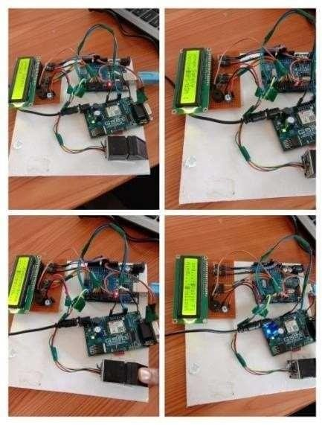
ACTUAL MODEL & ADVANTAGES
Is safe and easy to use.
Can be used by children, teenage girls, women, old lady or old men.
Mobile number can be changed at any time.

Slide 14
Disadvantages
Big in size.
Difficult to carry and move from one place to another.
Battery is always required .
SIM card is needed for GSM module.
Applications
For safety of the women.
Helps in child tracking.
To track regular offenders.
Further modifications is possible using face scanners and also flash lights to blind the offenders in the night.

Slide 15
Future Scope
Interface this system with SmartPhone or Mobile and laptop.
Used as a safety device in hand bags, luggage, vehicle etc.
Using Nano size materials, the kit size gets reduced.
Using wireless GPS module and wireless panic button the carrying of the kit can be avoided.
System can be interfaced with vehicle’s air bag system.

Slide 16


Slide 17



